Slide 1
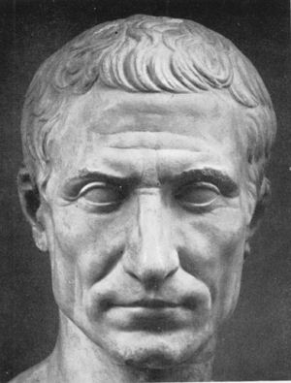

What does Julius Ceasar have in common with the transmission of modern digital signals?

Slide 2
CODES AND CODING

Slide 3
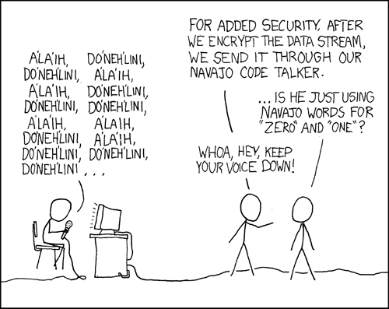
-two important things when making codes:
- accuracy
- secrecy

Slide 4
Error detection and correction
Morse code
invented in 19th century by Samuel Morse
used for sending the messages over the telegraph
consists of two symbols: dash – and dot ●
wasn’t good in error detection and correction

Slide 5
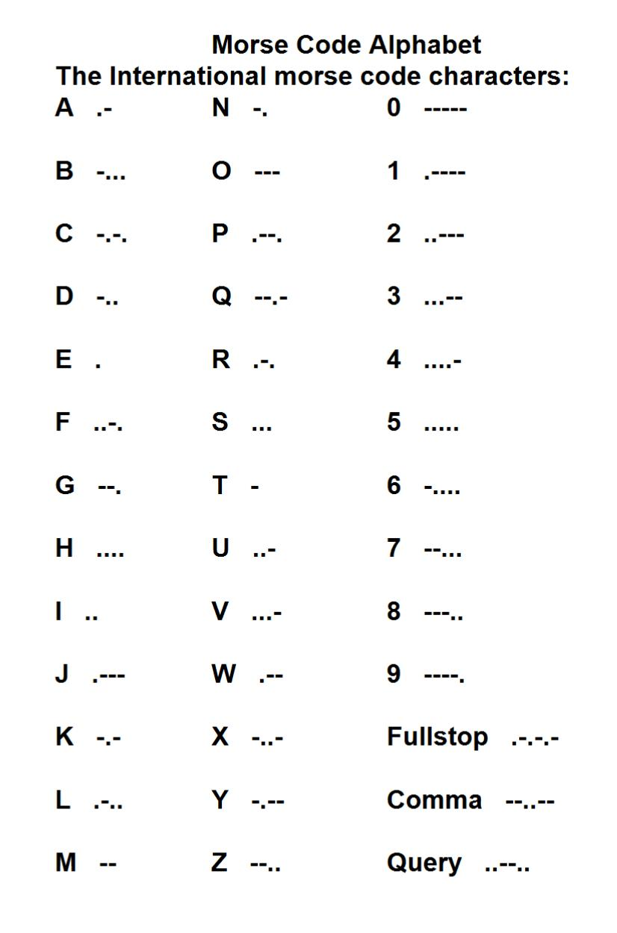

Slide 6
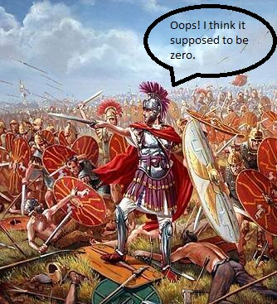
coding system consisting only of 1 and 0
1 = “invade”
0 = “do not invade”
incorrect transmission = disaster

Slide 7
improvement by using code words of length two or three
00 = “do not invade”, 11 = “invade”
000 = “do not invade”, 111 = “invade”
it makes it easier to detect error and correct it

Slide 8
autocorrect mode:
“animul” → “animal”
“lomp”
“lamp” “limp” “lump”

Slide 9
Making messages secret
Julius Ceasar – changing around the letters of his message according to a key that only he and his generals knew
Mary Queen of Scots – codes based on substitutions, but ones whose key could be uncovered by analysing the frequency of letters and symbols used
German Enigma

Slide 10
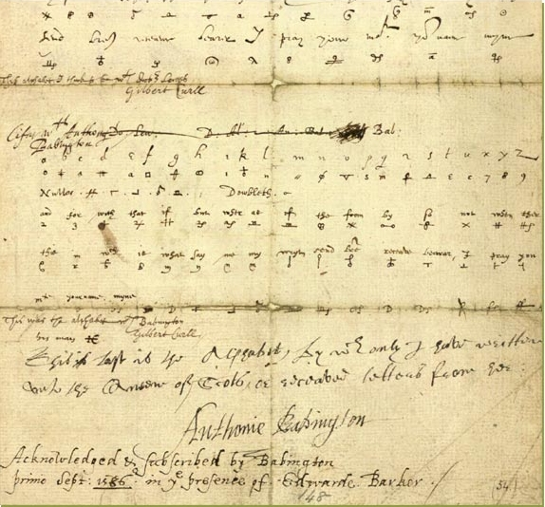
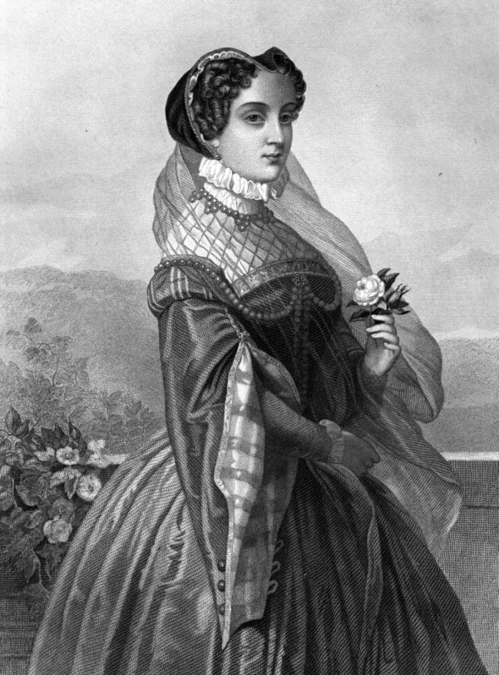
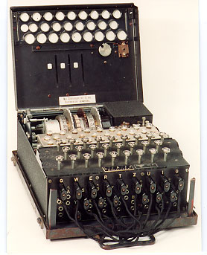

Slide 11
Public key encryption
discovered in the 1970s
the secret key could be broadcasted to all and yet message could remain entirely safe
the method depends on a 200 year old theorem in a branch of mathematics glorified for being the most useless of all

Slide 12
John Sender “J” Dr Reciever
Dr Reciever 247, 5
J – 74
74⁵ = 74*74*74*74*74 = 2 219 006 624
2 219 006 624 = 8 983 832 * 247 + 120

Slide 13
John Sender “J” ¹²⁰ Dr Reciever
p=13 q=19
5*a ≡ 1 modulo (p-1)(q-1)
a = 173
x ≡ 120¹⁷³ (modulo 247)
x = 74 – “J” is back in town

Slide 14
Can you break this code?
YAOROVSEUEETHNCS

Slide 15
This type of code is known as a Caesar Box (Julius Caesar was the first to write codes this way.) To decipher the message, simply divide the code into four groups of four, and rearrange them vertically like this...
YAOR
OVSE
UE..

Slide 16
And now this one:
WEDHAEJEECHUCROASIEDVTPDE

Slide 17
Thank you for your time! ☺
Rebeka Čordaš

